Slide 1
Detection of small and far Traffic signs using Deep Learning
Part - 2

Slide 2
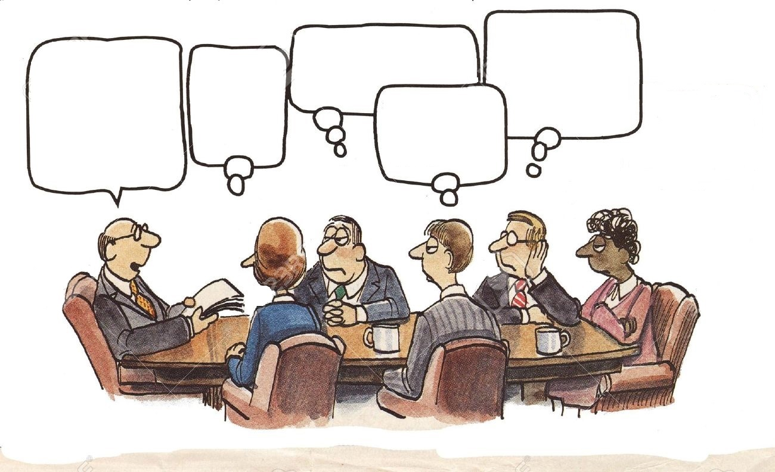
AGENDA
What is our Agenda?
Data Exploration &
Data
Preprocessing
Model and Methods
Conclusion
Results

Slide 3
Data Exploration

Slide 4
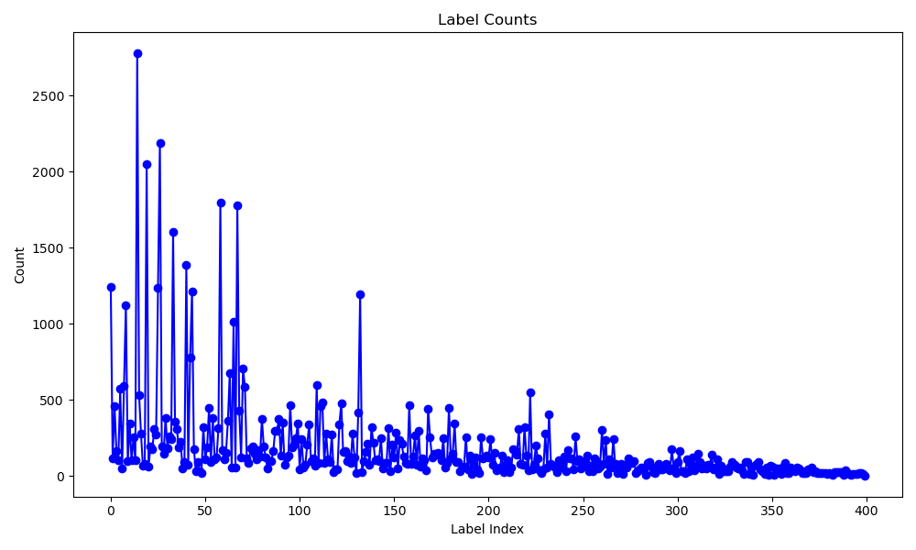
How is the dataset organised?
The MTSD dataset had total of 52,453 images of which 41,909 images were accompanied by annotations and additional 10,544 test images, which lacked annotations.
A comprehensive total of 374 unique labels were identified. The instances of these labels exhibited a wide spectrum, ranging from a minimum of 1 instance to maximum of 2800 instances.
Dataset distribution
Number of instances per label

Slide 5
Data Preprocessing

Slide 6
Steps to obtain clean data required for the model input
Merging the data
Merged the training and validation images to apply the common filtering process. Test images were used for inference as they do not have ground truth annotations provided.
374
Missing values / Improper labels
Verified whether the given dataset had any training or the validation images without the annotations or if there are any improper labels
374
PRE-PROCESSING STEPS
Filtering labels
18
No. of instances < 600
Improper distribution of small (<0.015), medium (0.015 – 0.15) , and large (>0.15) traffic signs
18
Normalizing the annotations
Split the data
Converted the annotations from .json to .txt
Transformed the xmax, xmin, ymax, ymin values to xc, yc, width, height
Normalized the values to fit in range of [0, 1]
To reduce the computation time, only 10 labels were chosen, thereby reducing size of the dataset. It was split into Training (6070), validation (1300), and test (1300)
10

Slide 7
Model Implementation

Slide 8
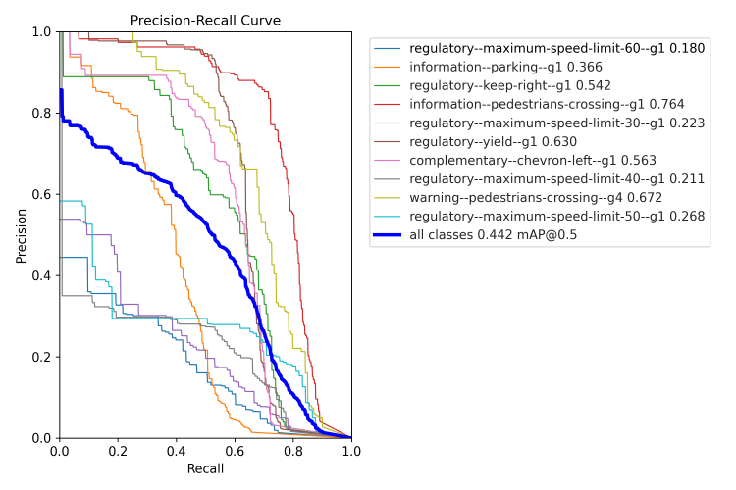
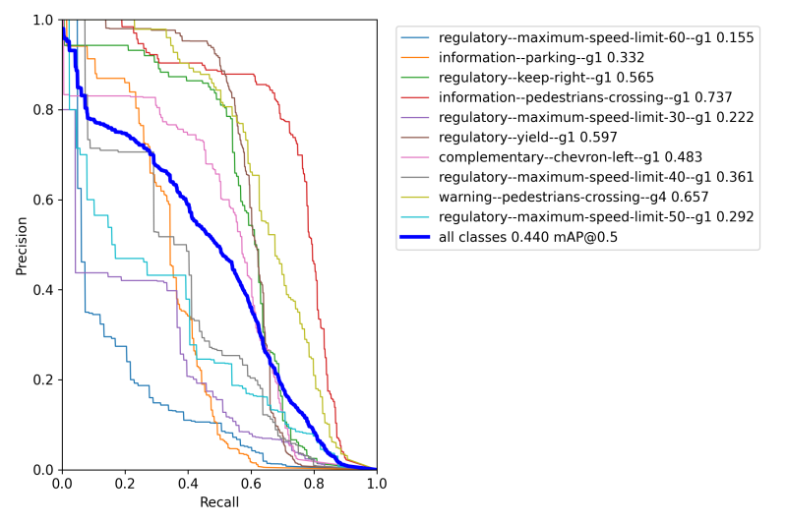
Method – 1 & 2
The NWD was introduced to calculate the localization loss. When the combination of NWD and CIoU was used as the loss function, mAP was increased by 4.2%, This shows that the introduction of NWD into the regression loss function is helpful in solving the sensitivity of the IoU-based metrics to small object position deviations.
K-means++ method was employed to replace the K-means algorithm in the original network. K-means++ is an optimization algorithm built on top of the K-means algorithm. Its main goals are to enhance the initial point selection, increase the efficiency of initializing training dataset's anchor box, and boost the model's ability to recognize small objects with more accuracy.
P-R curve for Baseline with NWD + CIoU loss
P-R curve for Baseline & K-Means++

Slide 9
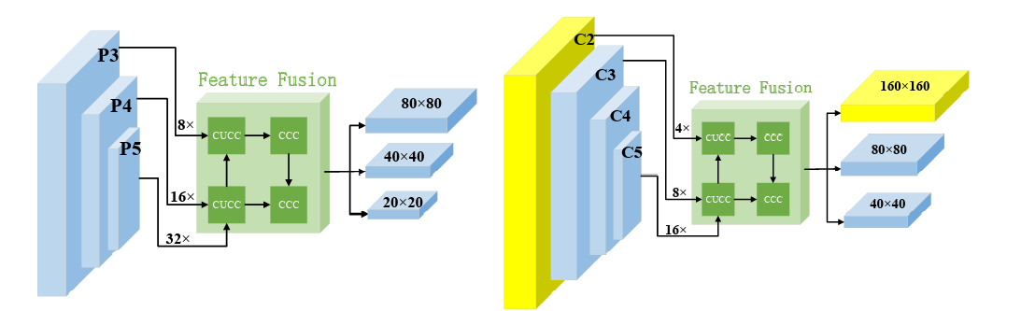

Method – 3
Instead of 32 times of down sampling, 16 times were used in the feature extraction phase to prevent the loss of small object information during feature propagation. To compensate for the reduction in the receptive field brought on by the adjustment of the subsampling process, the C3 module was replaced with a feature extraction module (C4) that has a stronger characterization capability.
{C2, C3, C4, C5} are the feature maps after the input image has been down-sampled {4, 8, 16, 16} times, respectively. After multi-scale fusion, the model was able to learn object features more effectively, improve the network's capacity to capture smaller objects and boost the effectiveness of object identification.
Modified architecture with C4 module
P-R curve for M-YOLOv5 (Baseline + all 3 methods)
Ref: Sensors | Free Full-Text | STC-YOLO: Small Object Detection Network for Traffic Signs in Complex Environments (mdpi.com)

Slide 10

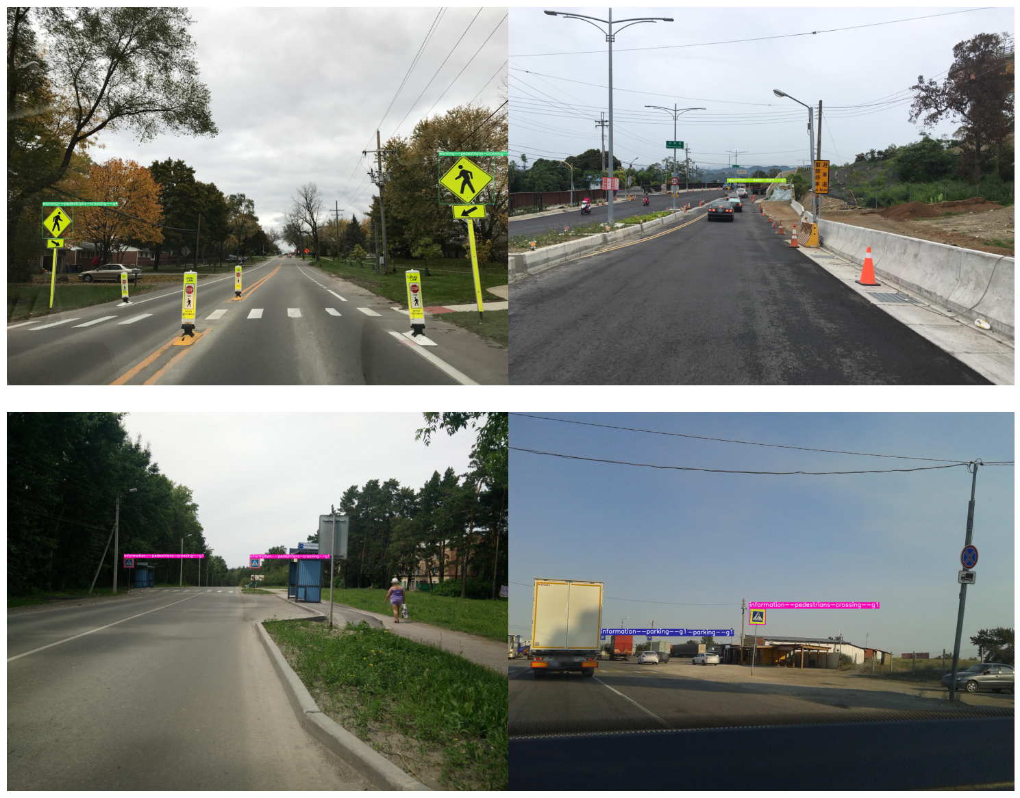
Summary
Baseline | K-Means++ | NWD+CIoU | C4 | mAP (%) | Params (M) | GFLOPS
 |  |  |  | 39.8 | 7.04 | 16
 |  |  |  | 44.2 | 7.04 | 16
 |  |  |  | 44.0 | 7.04 | 16
 |  |  |  | 42.4 | 7.19 | 18.9
 |  |  |  | 44.7 | 7.19 | 18.9
 |  |  |  | 46.0 | 7.19 | 18.9

Slide 11
Conclusion

Slide 12
Is there a possibility to improve the model?
Data Augmentation
M-YOLO algorithm's resistance to dark conditions has not been tested. Datasets could one day be gathered with the goal of detecting traffic signs in scenery at night or images can be generated using data augmentation techniques.
Model training
The performance and stability of the model should be further optimized by using a high-resolution image for the model input and training the model for more epochs.
Detailed analysis
Dataset can be divided further by splitting each label into subclasses such as small-informatory, medium-informatory, large-informatory etc. to evaluate the model on each scale of detection.
Model structure
The architecture of the model can be modified to include more convolution layers (suitable for small sign detections) and more anchor boxes which are capable of detecting signs at different scales.

Slide 13
Thank you

Slide 14
Appendix

Slide 15
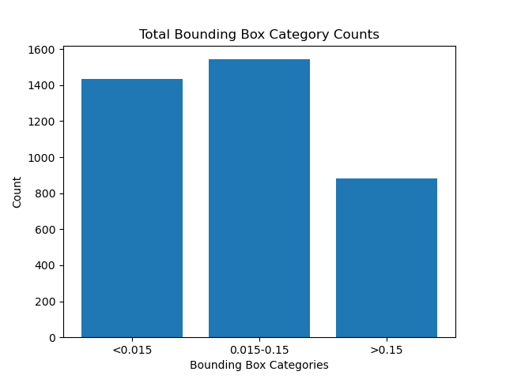
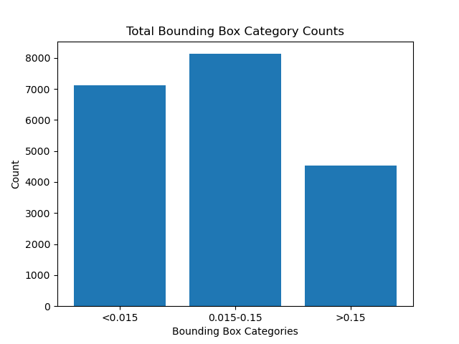

Slide 16
Base Model anchor box values:
- [ 10,13, 16,30, 33,23 ] # P3/8
- [ 30,61, 62,45, 59,119 ] # P4/16
- [ 116,90, 156,198, 373,326 ] # P5/32
Kmeans++ anchor box values:
- [3.1,5.1, 5.5,8.85, 8.57,13.78] # P3/8
- [12.75,19.25, 17.92,27.64, 25.10,39.14] # P4/16
- [35.69,51.76, 51.64,74.52, 78.93,118.98] # P5/32

Slide 17
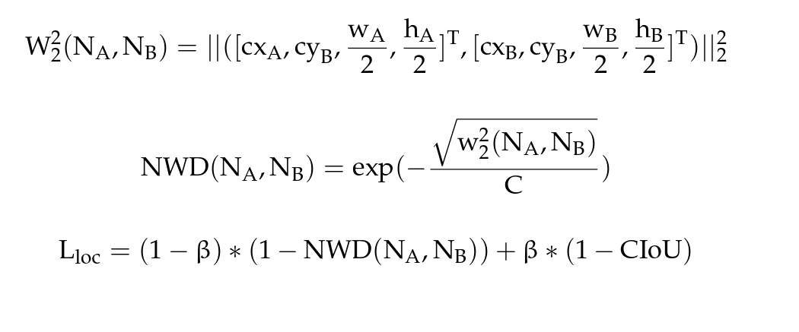
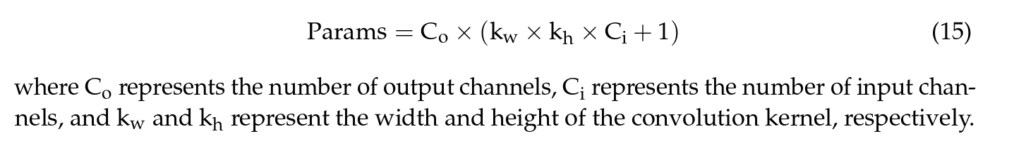
where NA and NB are Gaussian distributions modeled by A = (cxA,cyA,wA,hA) and B =(cxB,cyB,wB,hB), W2 2(NA,NB) is a distance measure, c is a constant closely related to the dataset, and is the weight proportional coefficient.

